Slide 1
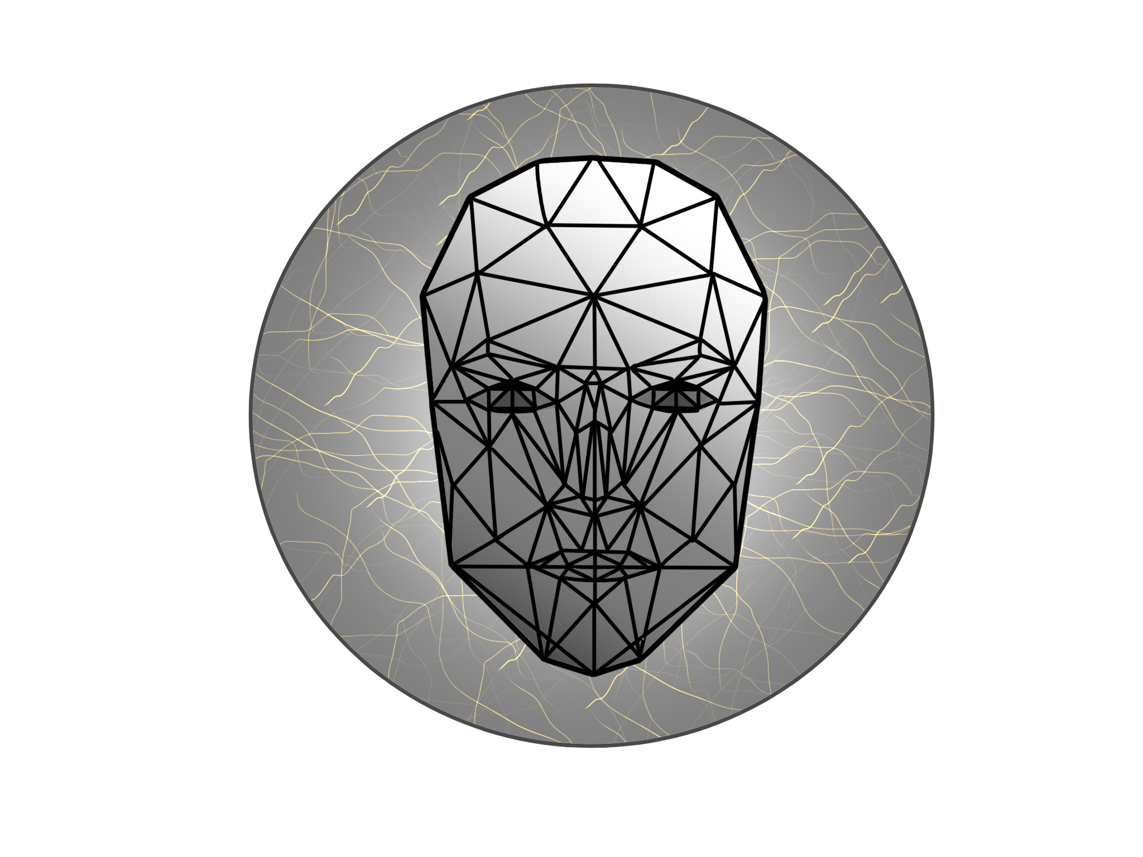




FACECODERS
Anna Preczyńska
Yurii Shcheoholiev
Mariusz Pisarski
Michał Suliborski
Notes:
1 First slide covers the Title of your Project/Research Your Supervisor and co-supervisor Name the all of your team members Along with your identity numbers

Slide 2

BACKGROUND
Notes:
2 In this slide you just write the content of your this presentation what you are about to discuss right now about your project
2 Briefly discuss which systems made already relates with your project What improvements you made in your project Background / introduction of your system Which main points/issues your system covers

Slide 3

BACKGROUND
Notes:
2 In this slide you just write the content of your this presentation what you are about to discuss right now about your project
2 Briefly discuss which systems made already relates with your project What improvements you made in your project Background / introduction of your system Which main points/issues your system covers

Slide 4

Problem definition
Notes:
3 Importance and need of your project What ever you observed before starting of this system, what main problem/limitations you found that this problem should be eliminated. What kinds of people can use your system and where it can be used

Slide 5
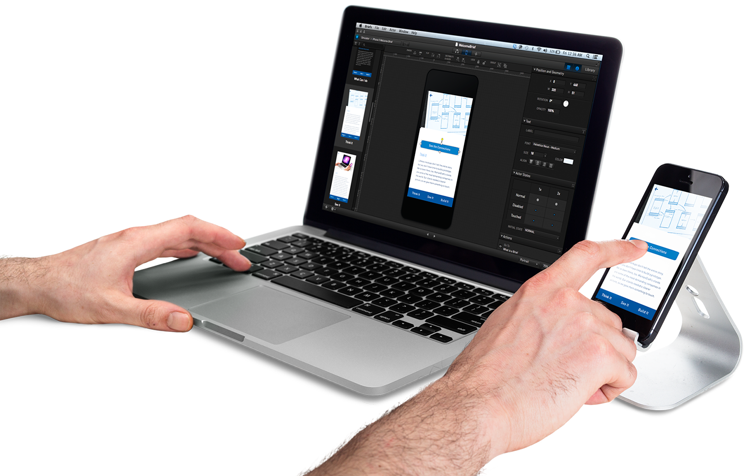
Mobile app

Slide 6


Tools
.
Notes:
5 Tools and Technologies Which technologies you used while developing your project, just make audience clear about what, where you needed that technology and why you have preferred that particular technology for your project why not others

Slide 7


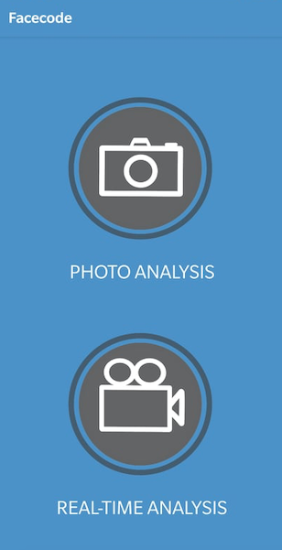
1
2
3

Slide 8



Technologies
Notes:
5 Tools and Technologies Which technologies you used while developing your project, just make audience clear about what, where you needed that technology and why you have preferred that particular technology for your project why not others

Slide 9
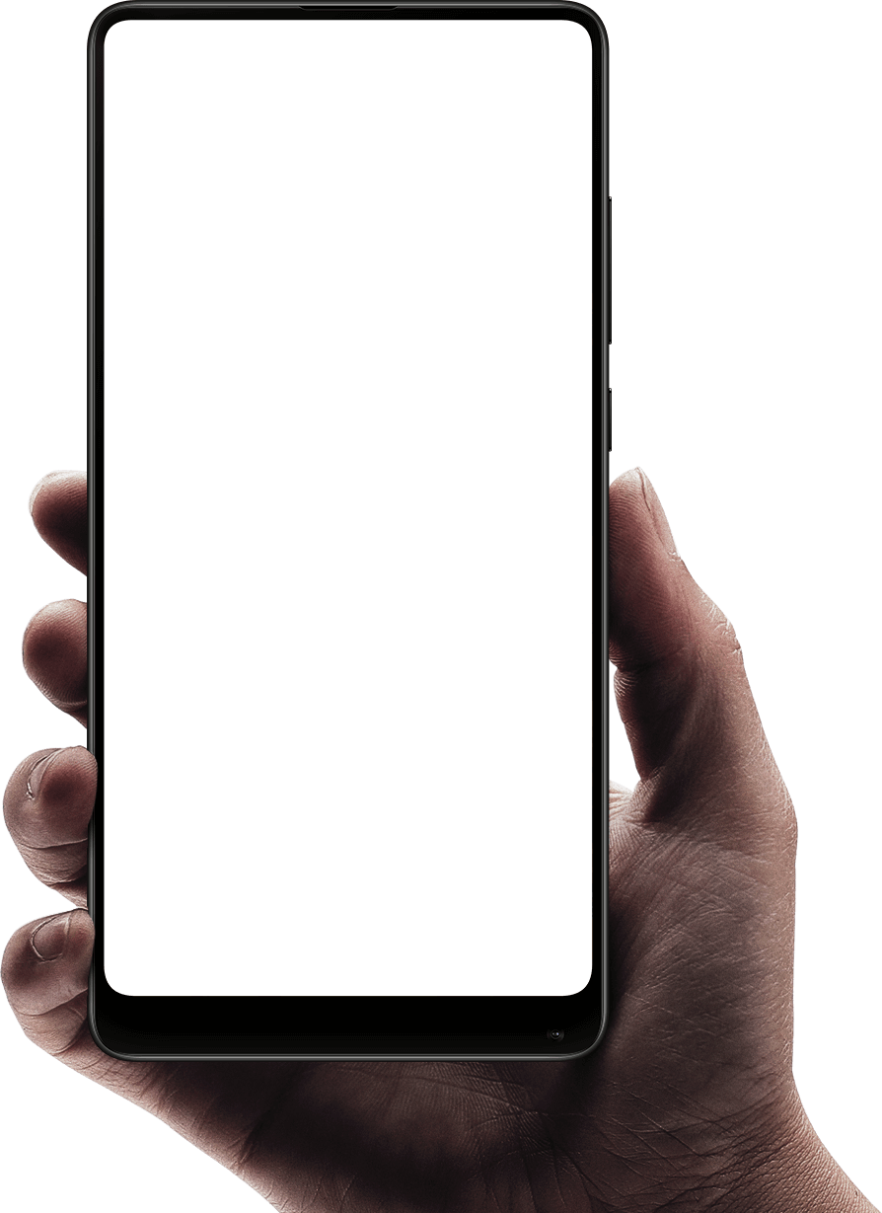

Notes:
6 System/User requirements What are prerequisite of a system to run this project If system is common user based then what are the requirements that a public should fulfill.

Slide 10
Deep learning

Slide 11
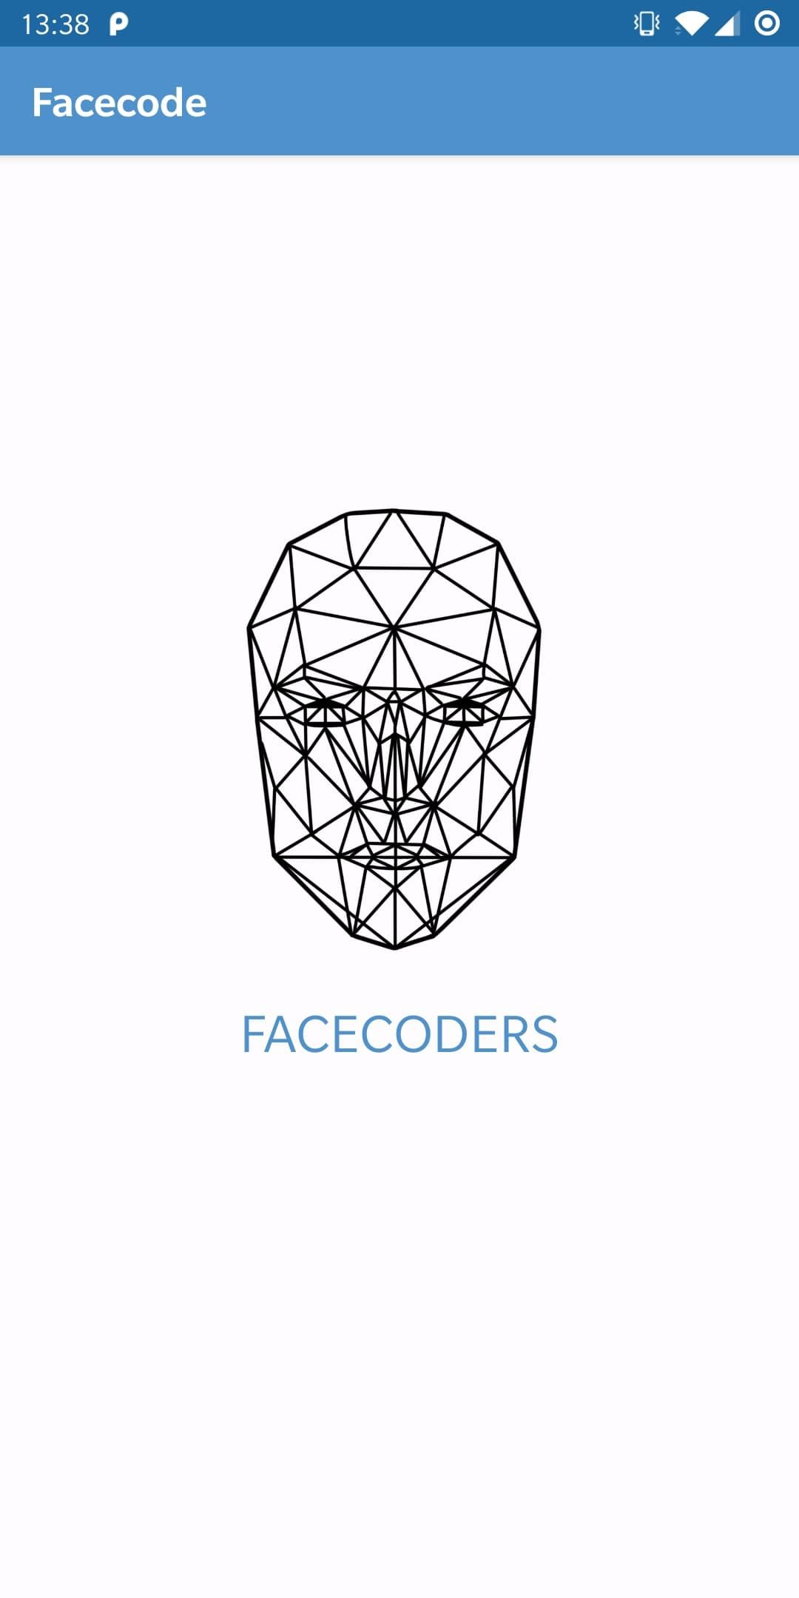
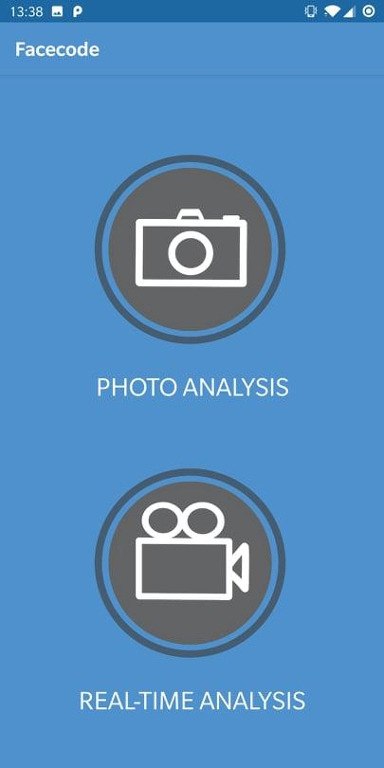
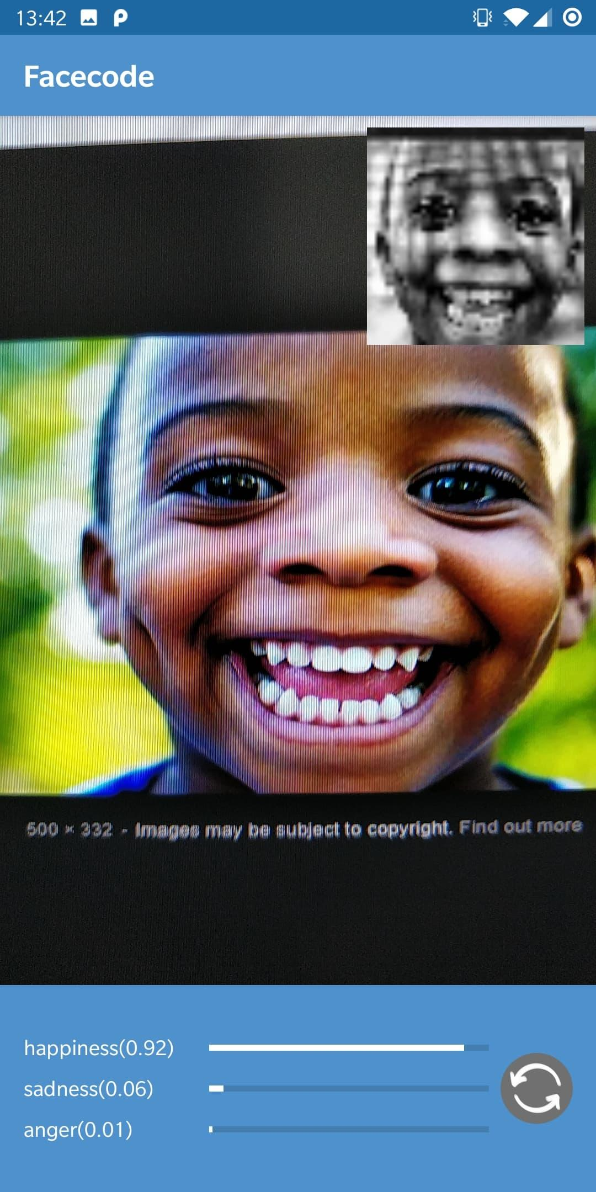
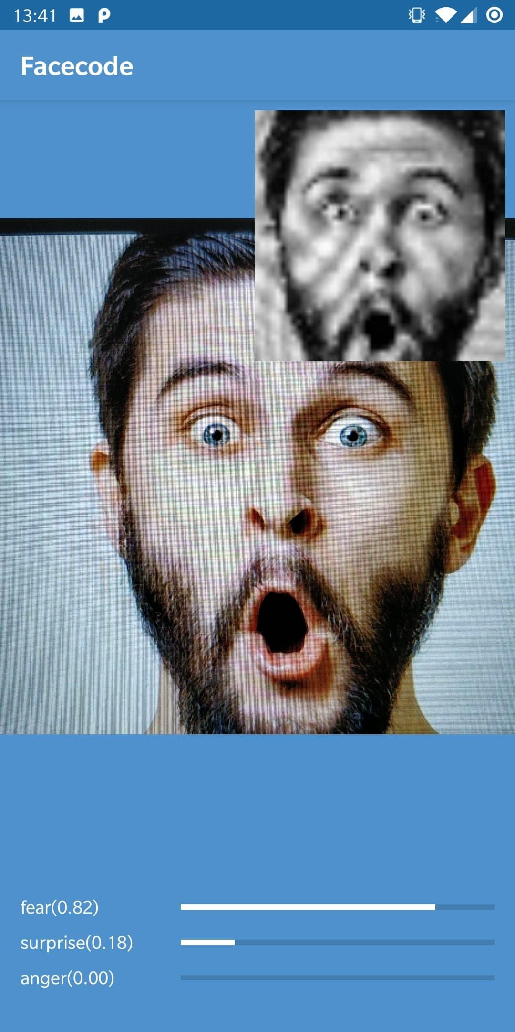
Notes:
8 to --- Snapshots of system Take main and important snaps of your project

Slide 12

Conclusions
Notes:
9 Finally conclude your project

Slide 13
ANY
QUESTIONS?

Slide 14




Any problem?
Notes:
kisspng.com

